Slide 1



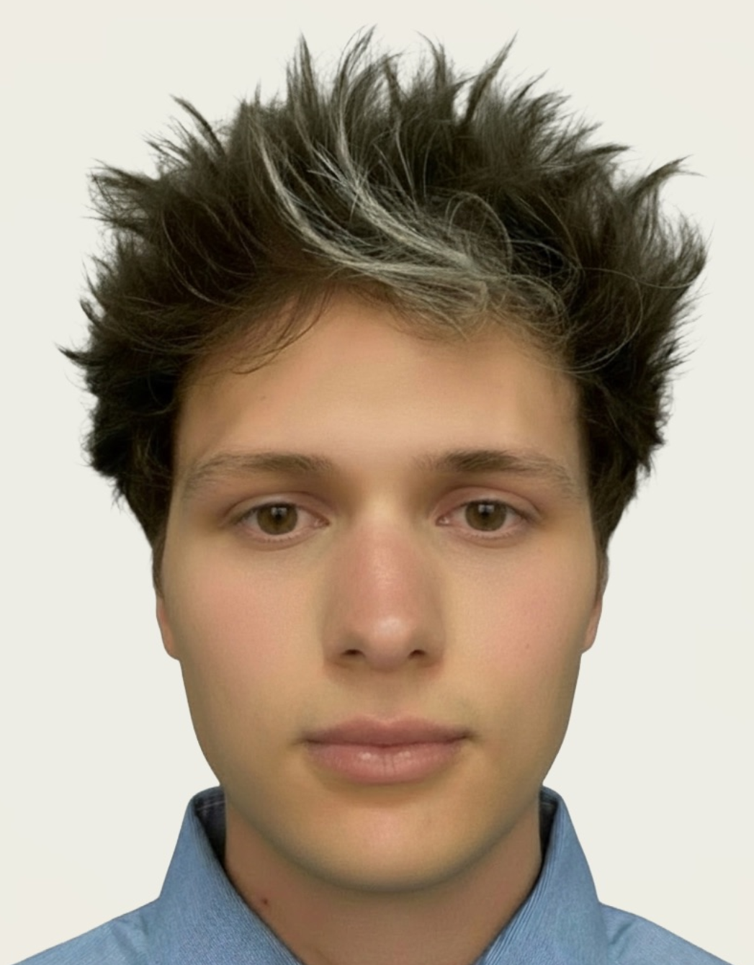

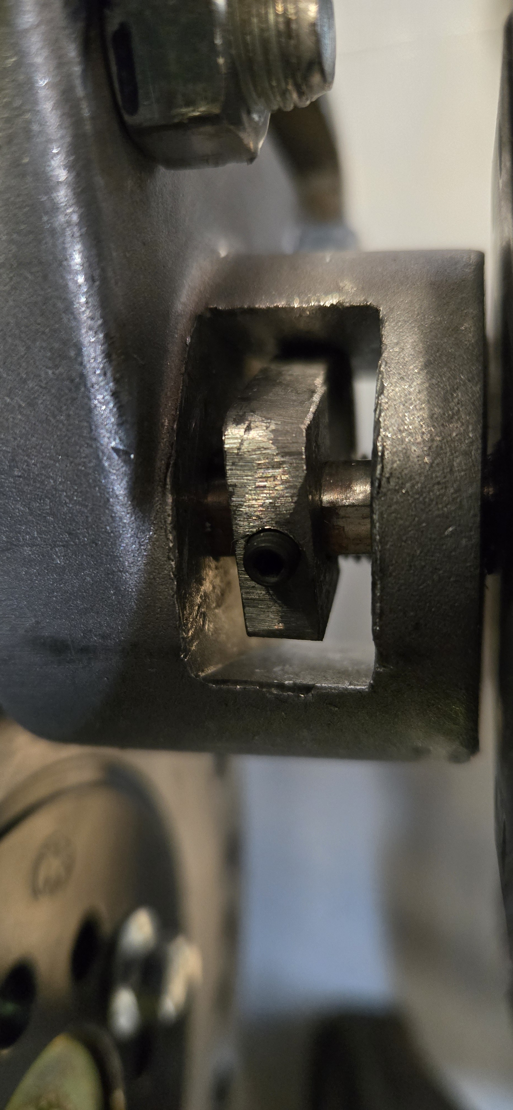
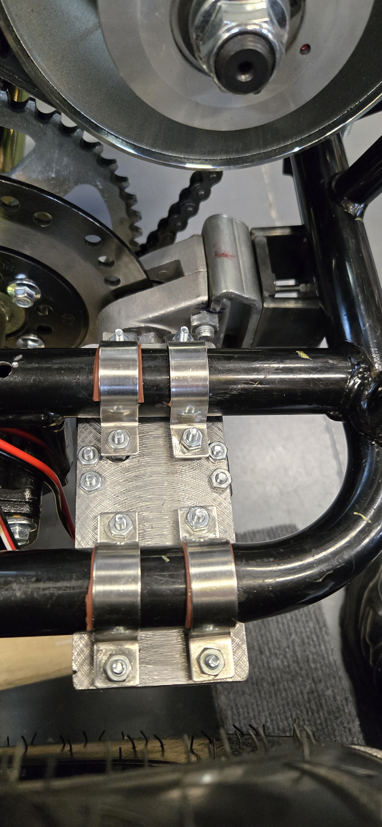
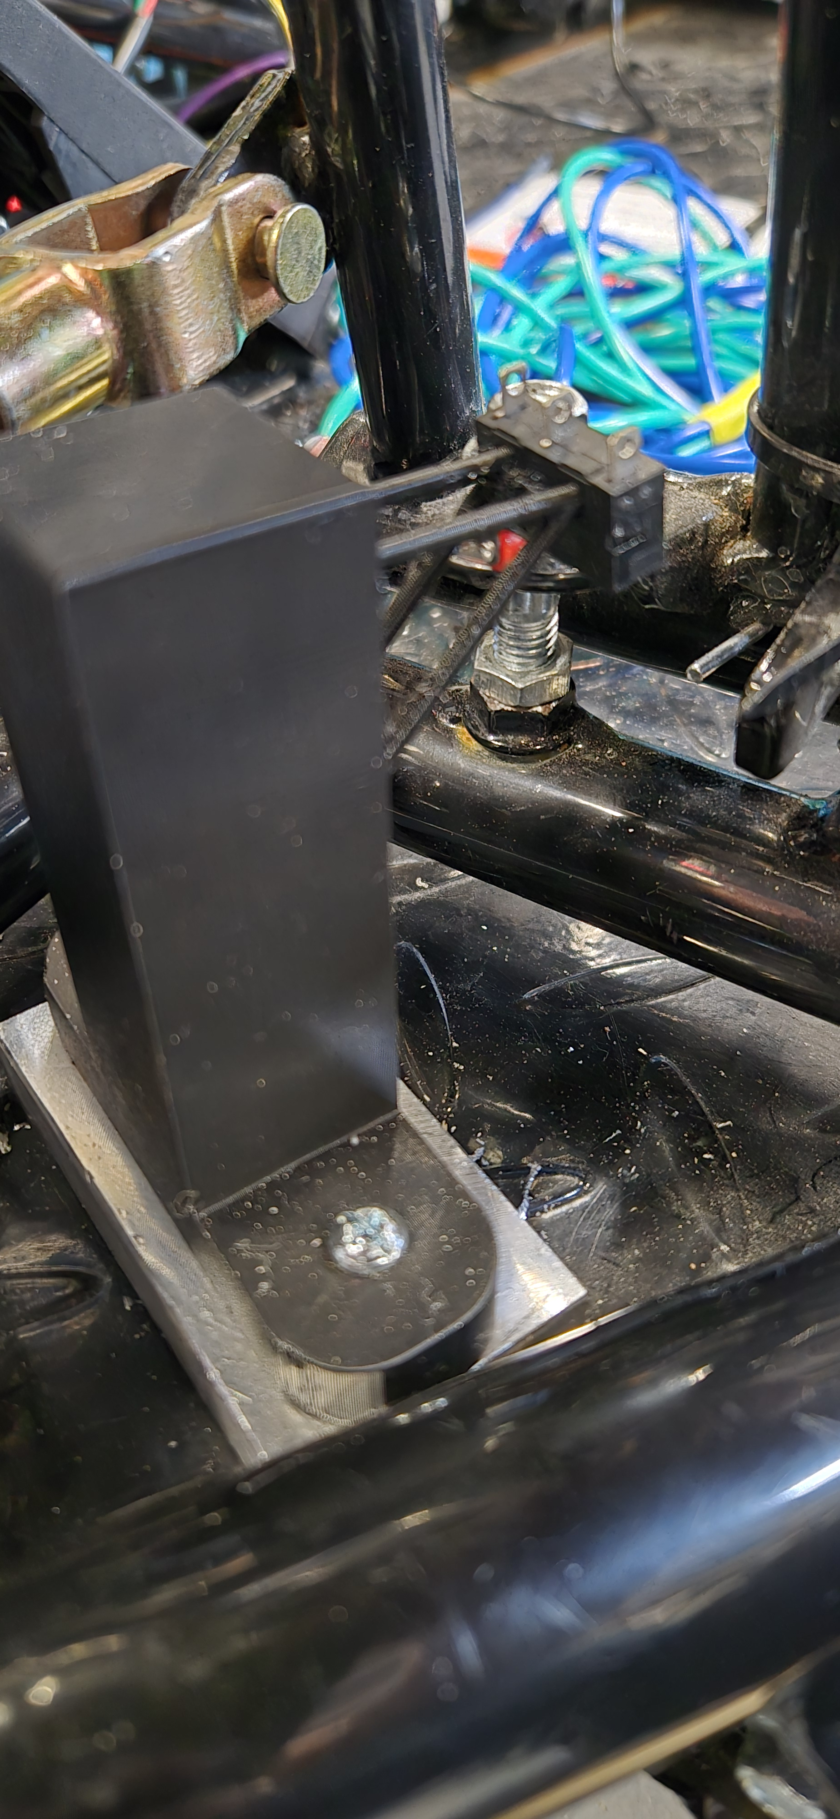
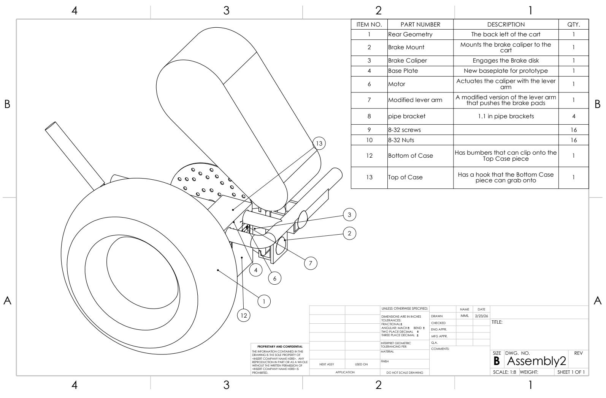
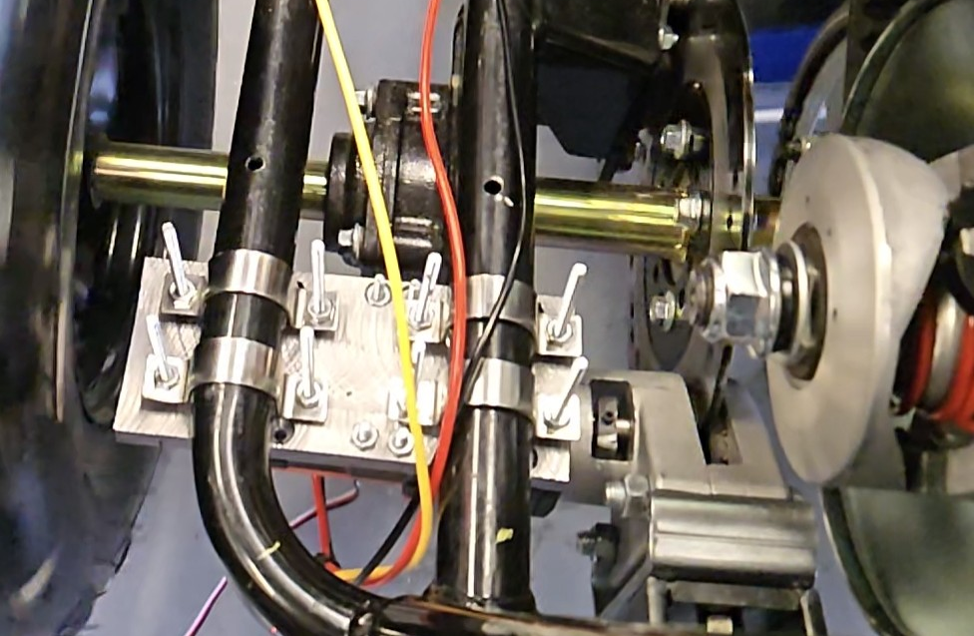

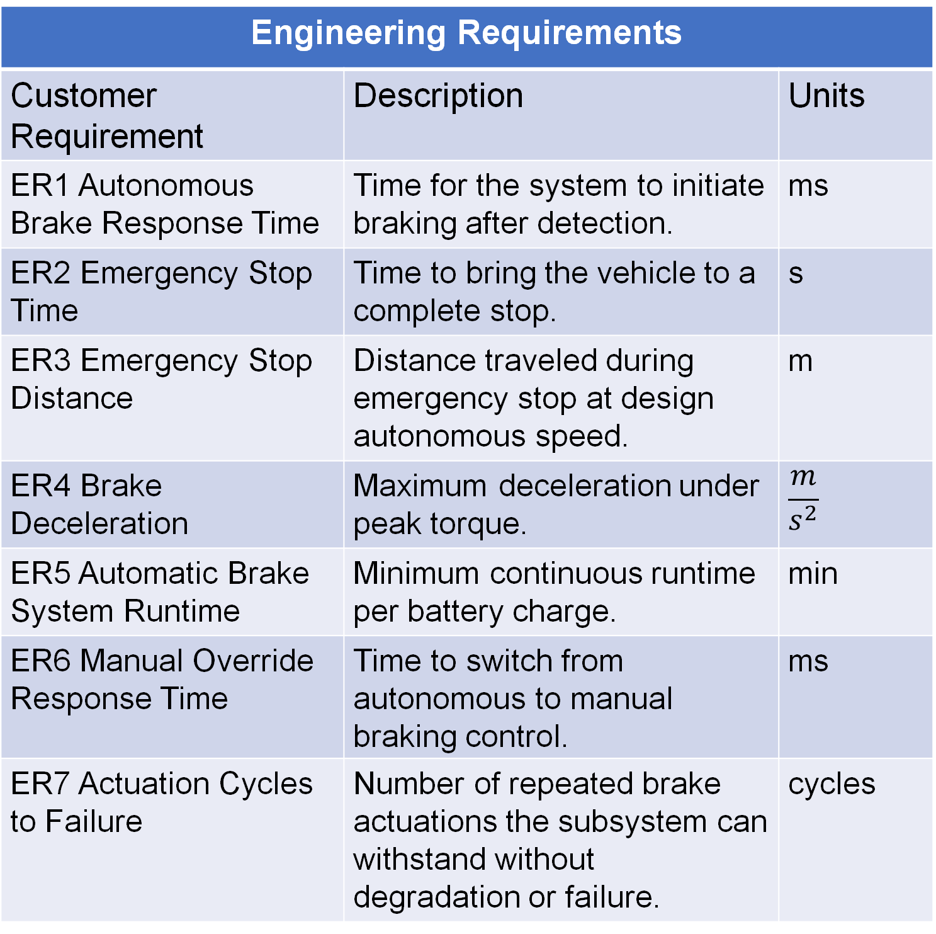
Boeing Sponsored Retrofitted Go-Kart for Autonomous Driving - Brakes
Spring 2026
Jacob Keeland Marek Lemieux
Steve Sanghi College of Engineering Northern Arizona University, Flagstaff, AZ 86011
Abstract
Methods
Conclusion
We developed a reliable autonomous braking system for the retrofitted go-kart. It enables fast emergency stops and obstacle avoidance while always keeping full manual override and driver safety.
Our team designed and manufactured a motor-driven actuator that integrates directly with the stock brake caliper. We performed torque and stopping-distance calculations and created testing protocols to verify response time, durability, and performance in dry and wet, conditions.
A motor fixed to the rear of the kart actuates a brake caliper positioned on the brake disk. This design allows the main brake line open in case of emergencies and allows autonomous braking
The team started with performing calculations related to the design before moving to prototyping, testing, and optimization
General testing procedure required a mechanical engineering member from any involved sub teams and at least one electrical engineer familiar with the subsystem being tested
Every member was to know and notify others of relevant testing which included a testing procedure document reviewed by the electrical engineers
Personal protective equipment based on the test, always a helmet for the operator.
Topic & Importance
The braking subsystem demonstrates fast, reliable performance for safe retrofit automation.
Project Claim
The motor-driven caliper stops a 204 kg kart from 2.24 m/s in 1.14 s (1.28 m) or 0.49 s (0.55 m), meeting all response, safety, and runtime requirements while preserving manual override.
Opposing Viewpoint
Despite concerns about retrofit reliability, testing confirms a lower-cost, safe, and effective solution.
Future Work
A hydraulic braking system is proposed to further improve performance and scalability.
Requirements
Results
References
Customer Requirements
Customer Requirement | Description
CR1 Autonomous Braking | Vehicle applies brakes without human intervention.
CR2 Emergency Stop | System performs a complete emergency stop.
CR3 Manual Override | Full manual control is always available and intuitive.
CR4 Safety | Braking system maintains reliable performance in dry and wet conditions.
CR5 Usability | Automatic brake system supports extended operation per battery charge.
[1] D. Halliday and R. Resnick, Fundamentals of Physics, 10th ed. Hoboken, NJ: Wiley, 2013.
[2] J. D. Halderman, Automotive Brake Systems, 7th ed. Boston, MA: Pearson, 2019.
[3] M. Haataja and T. Leinonen, “On the distribution of braking forces in road braking,” SAE Technical Paper Series, Dec. 2000. doi:10.4271/2000-01-3413
[4] P. S. Bokare and A. K. Maurya, “Acceleration-deceleration behavior of various vehicle types,” Transportation Research Procedia, vol. 25, pp. 4733–4749, 2017. doi:10.1016/j.trpro.2017.05.486
[5] S. G. Shadle, L. H. Emery, and H. K. Brewer, “Vehicle Braking, Stability and Control,” Login - CAS – central authentication service, https://www-jstor-org.libproxy.nau.edu/stable/44668097?seq=6 (accessed Sep. 14, 2025).
Brake Puck
Brake Final Prototype
Emergency Manual Toggle
 | Target | Tolerance | Measured / Calculated Value | ER met? (✓ or X)
ER1 - Manual Override Response Time | ≤ 500 ms | ±50 ms | 250 ms | ✓
ER2 - Actuation Response Time | ≤ 100 ms | ±10 ms | 10 ms | ✓
ER3 - Brake Disengage Time | ≤ 100 ms | ±10 ms | 90 ms | ✓
ER4 – Time to Brake Kart | ≤ 1000 ms | ±0.100 ms | 830 ms | ✓
Engineering Requirements
Customer Requirement | Description | Units
ER1 Autonomous Brake Response Time | Time for the system to initiate braking after detection. | ms
ER2 Emergency Stop Time | Time to bring the vehicle to a complete stop. | s
ER3 Emergency Stop Distance | Distance traveled during emergency stop at design autonomous speed. | m
ER4 Brake Deceleration | Maximum deceleration under peak torque. | $$\frac{m}{s^{2}}$$
ER5 Automatic Brake System Runtime | Minimum continuous runtime per battery charge. | min
ER6 Manual Override Response Time | Time to switch from autonomous to manual braking control. | ms
ER7 Actuation Cycles to Failure | Number of repeated brake actuations the subsystem can withstand without degradation or failure. | cycles
Results from Initial Testing
Acknowledgements
We would like to thank our:
Clients at Boeing: Conner Nolan, Donald Guzman for providing funding and resources
Advisors: Professor David Willy and Teresa McLaurin for their guidance and feedback during this project
Supporters: RedRock Manufacturing, Canes, Chipotle, our friends and family who donated funding or resources
Top Level CAD for Brake Team
Final Prototype During Testing
Notes:
Marek: Results, Methods,
Conclusion and references for both
Jake: Abstract, Requirements,

Slide 2



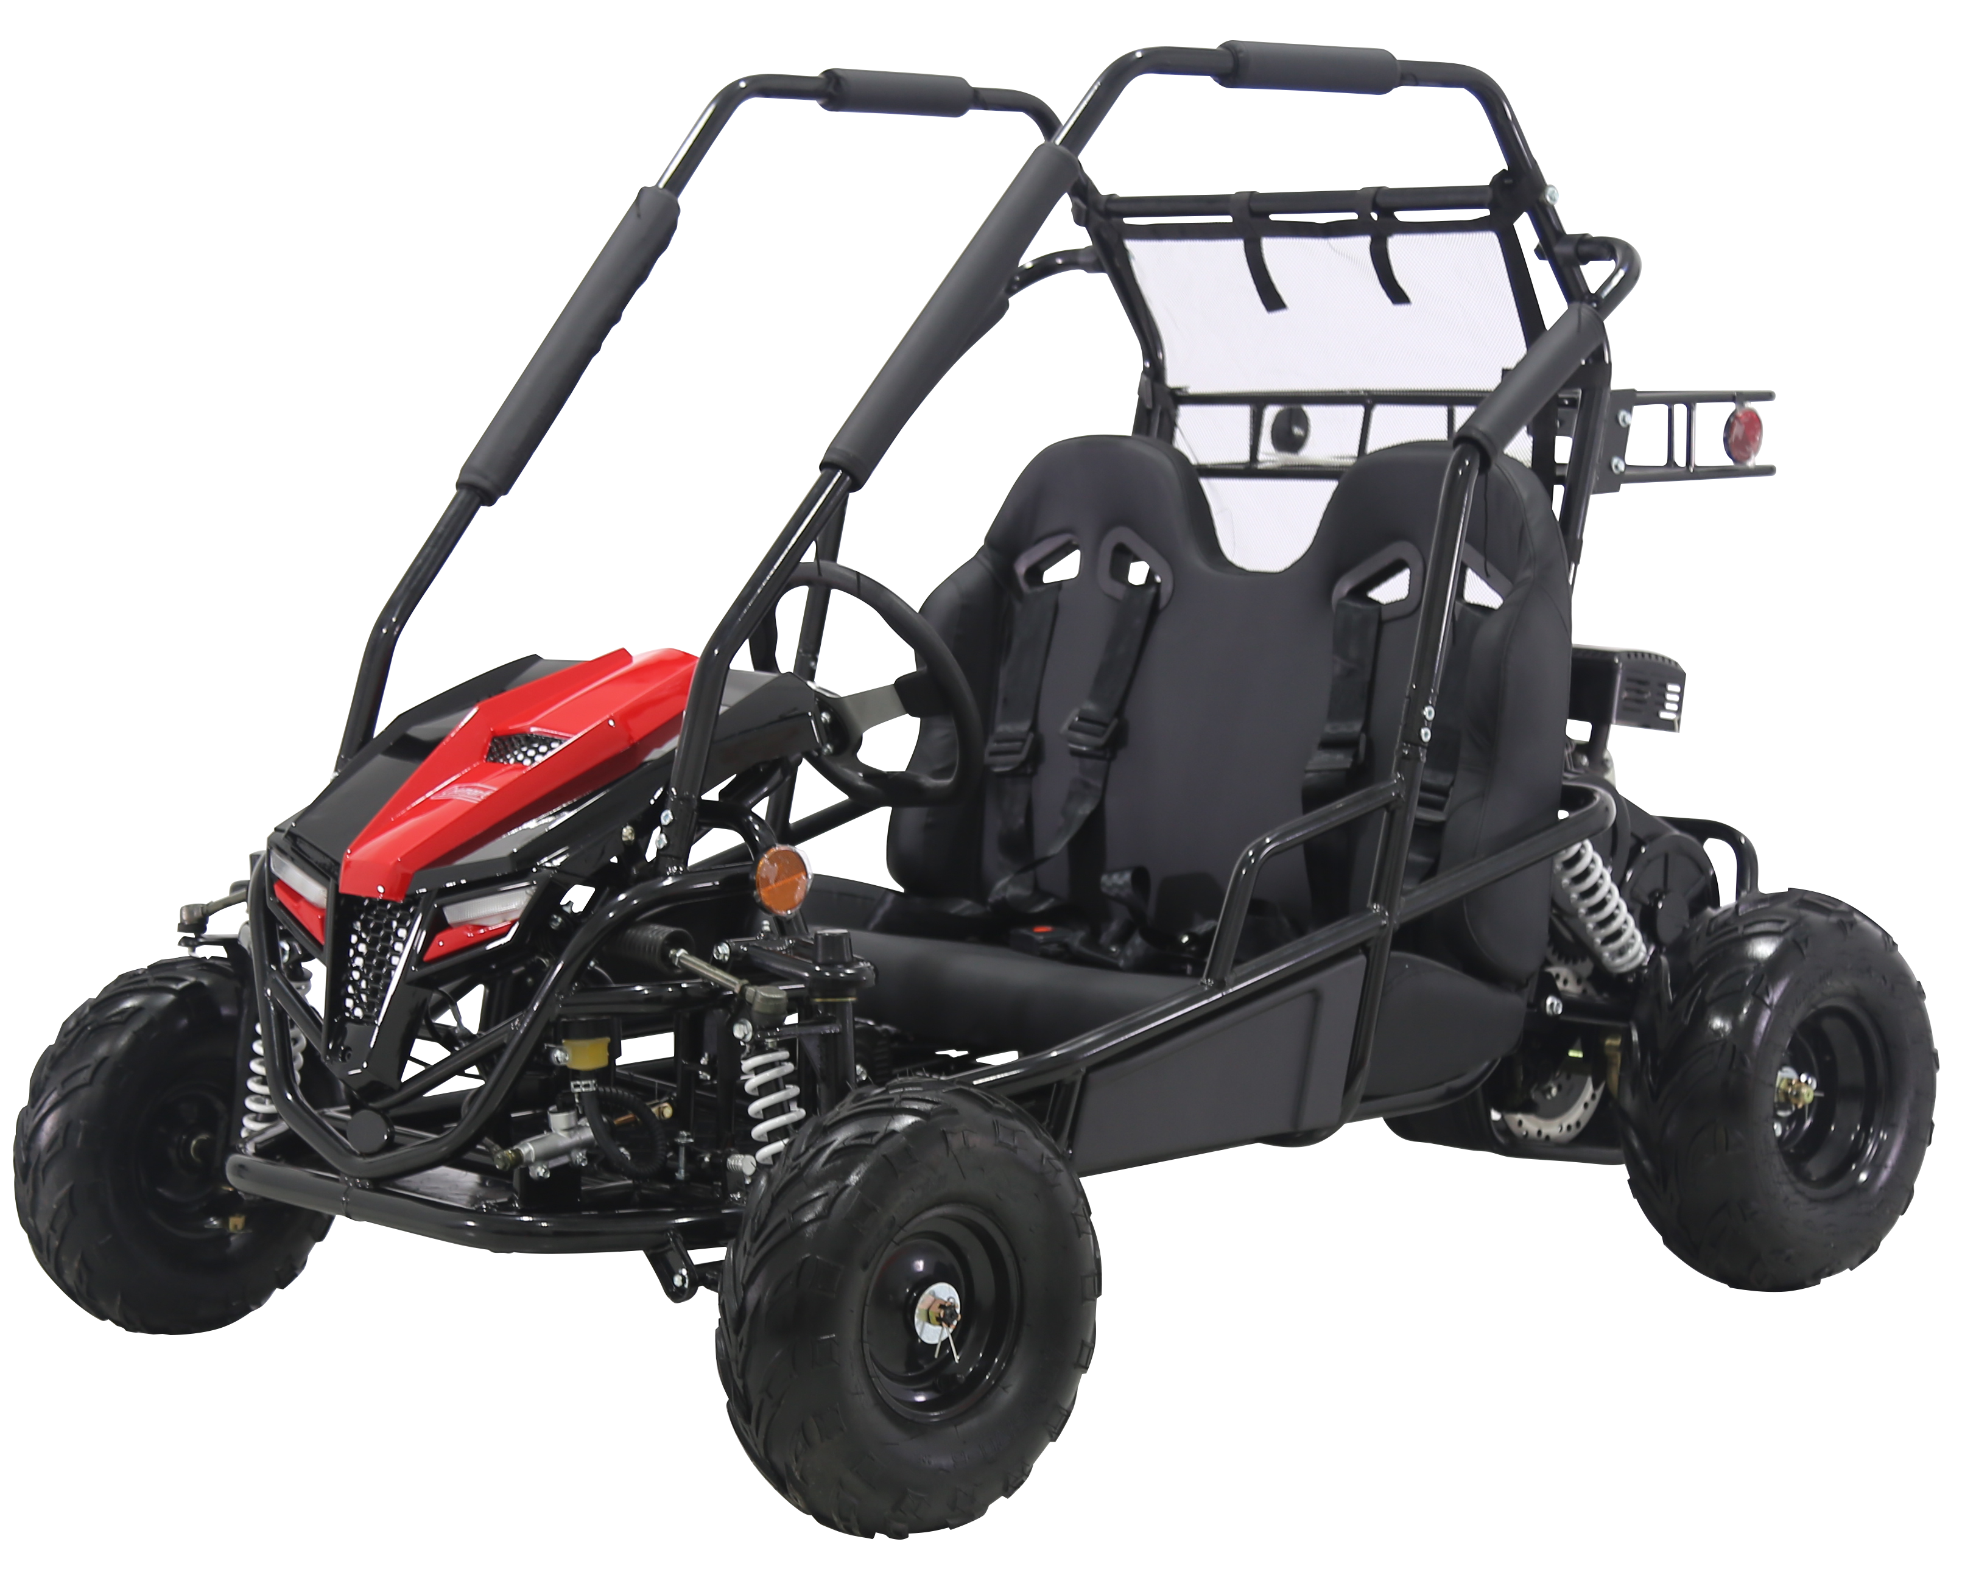
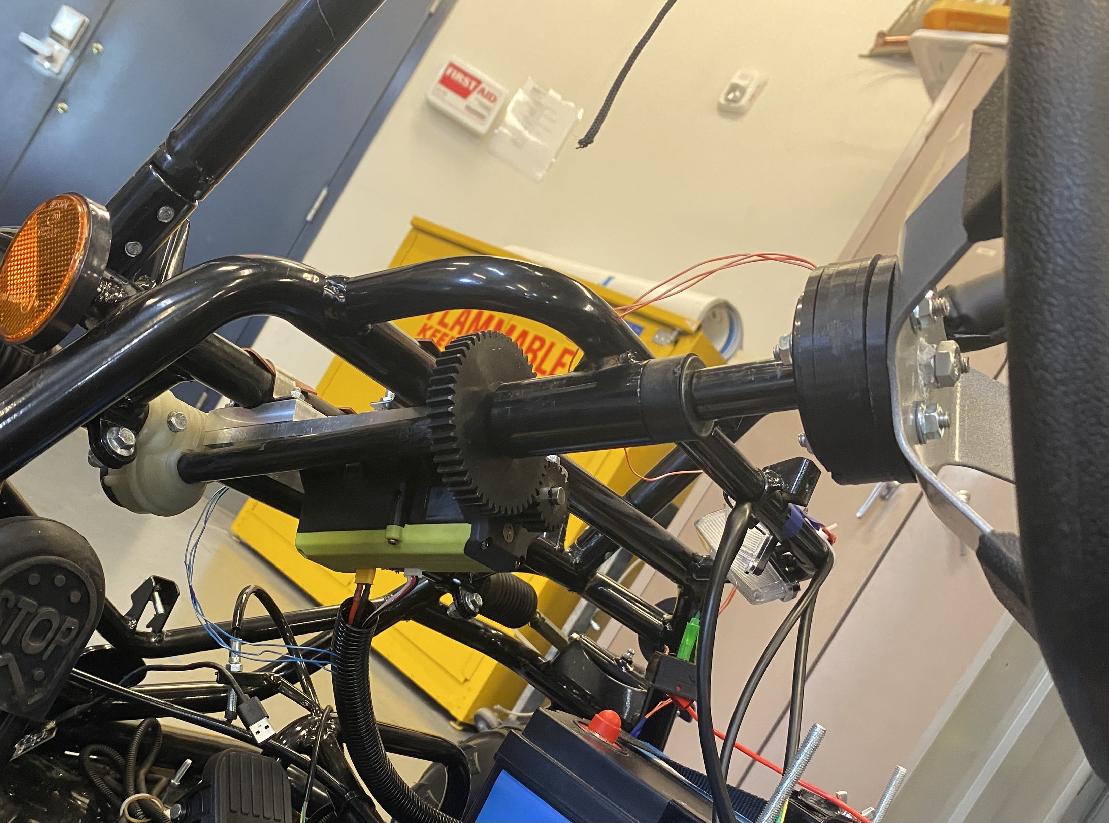
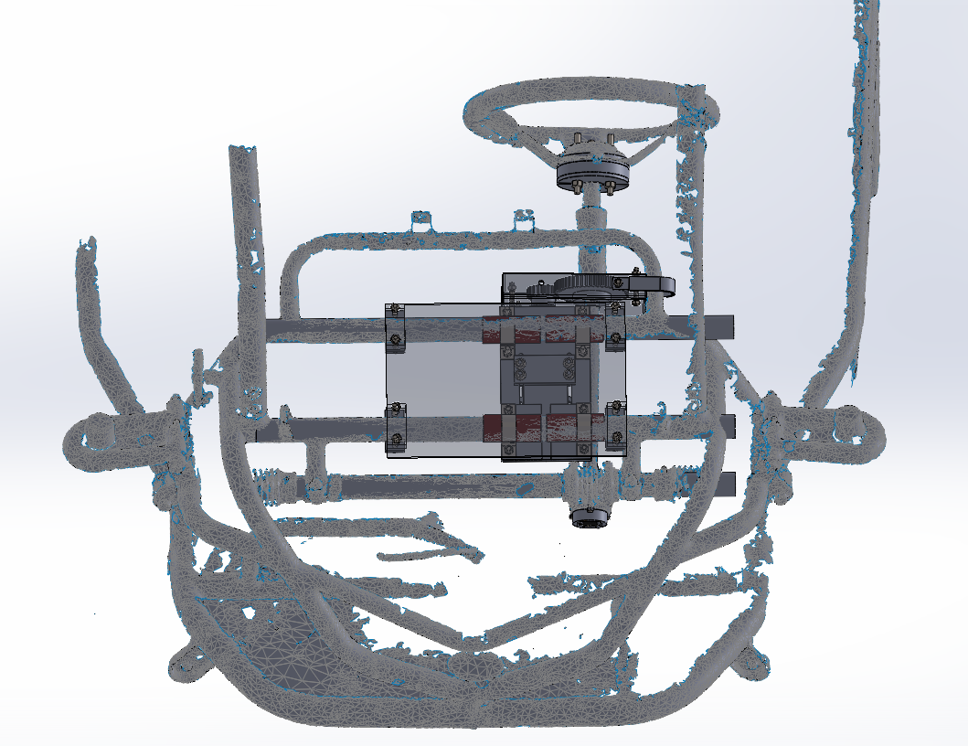
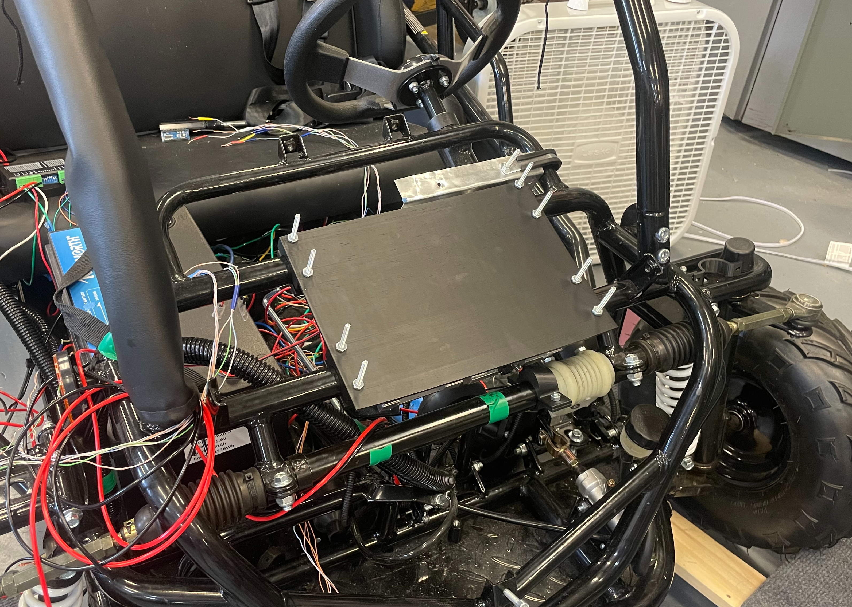
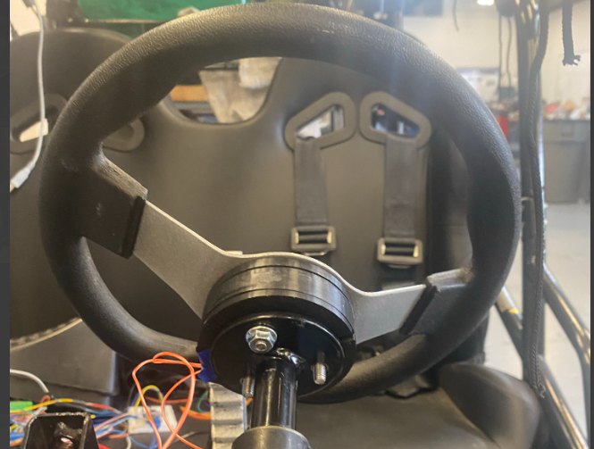
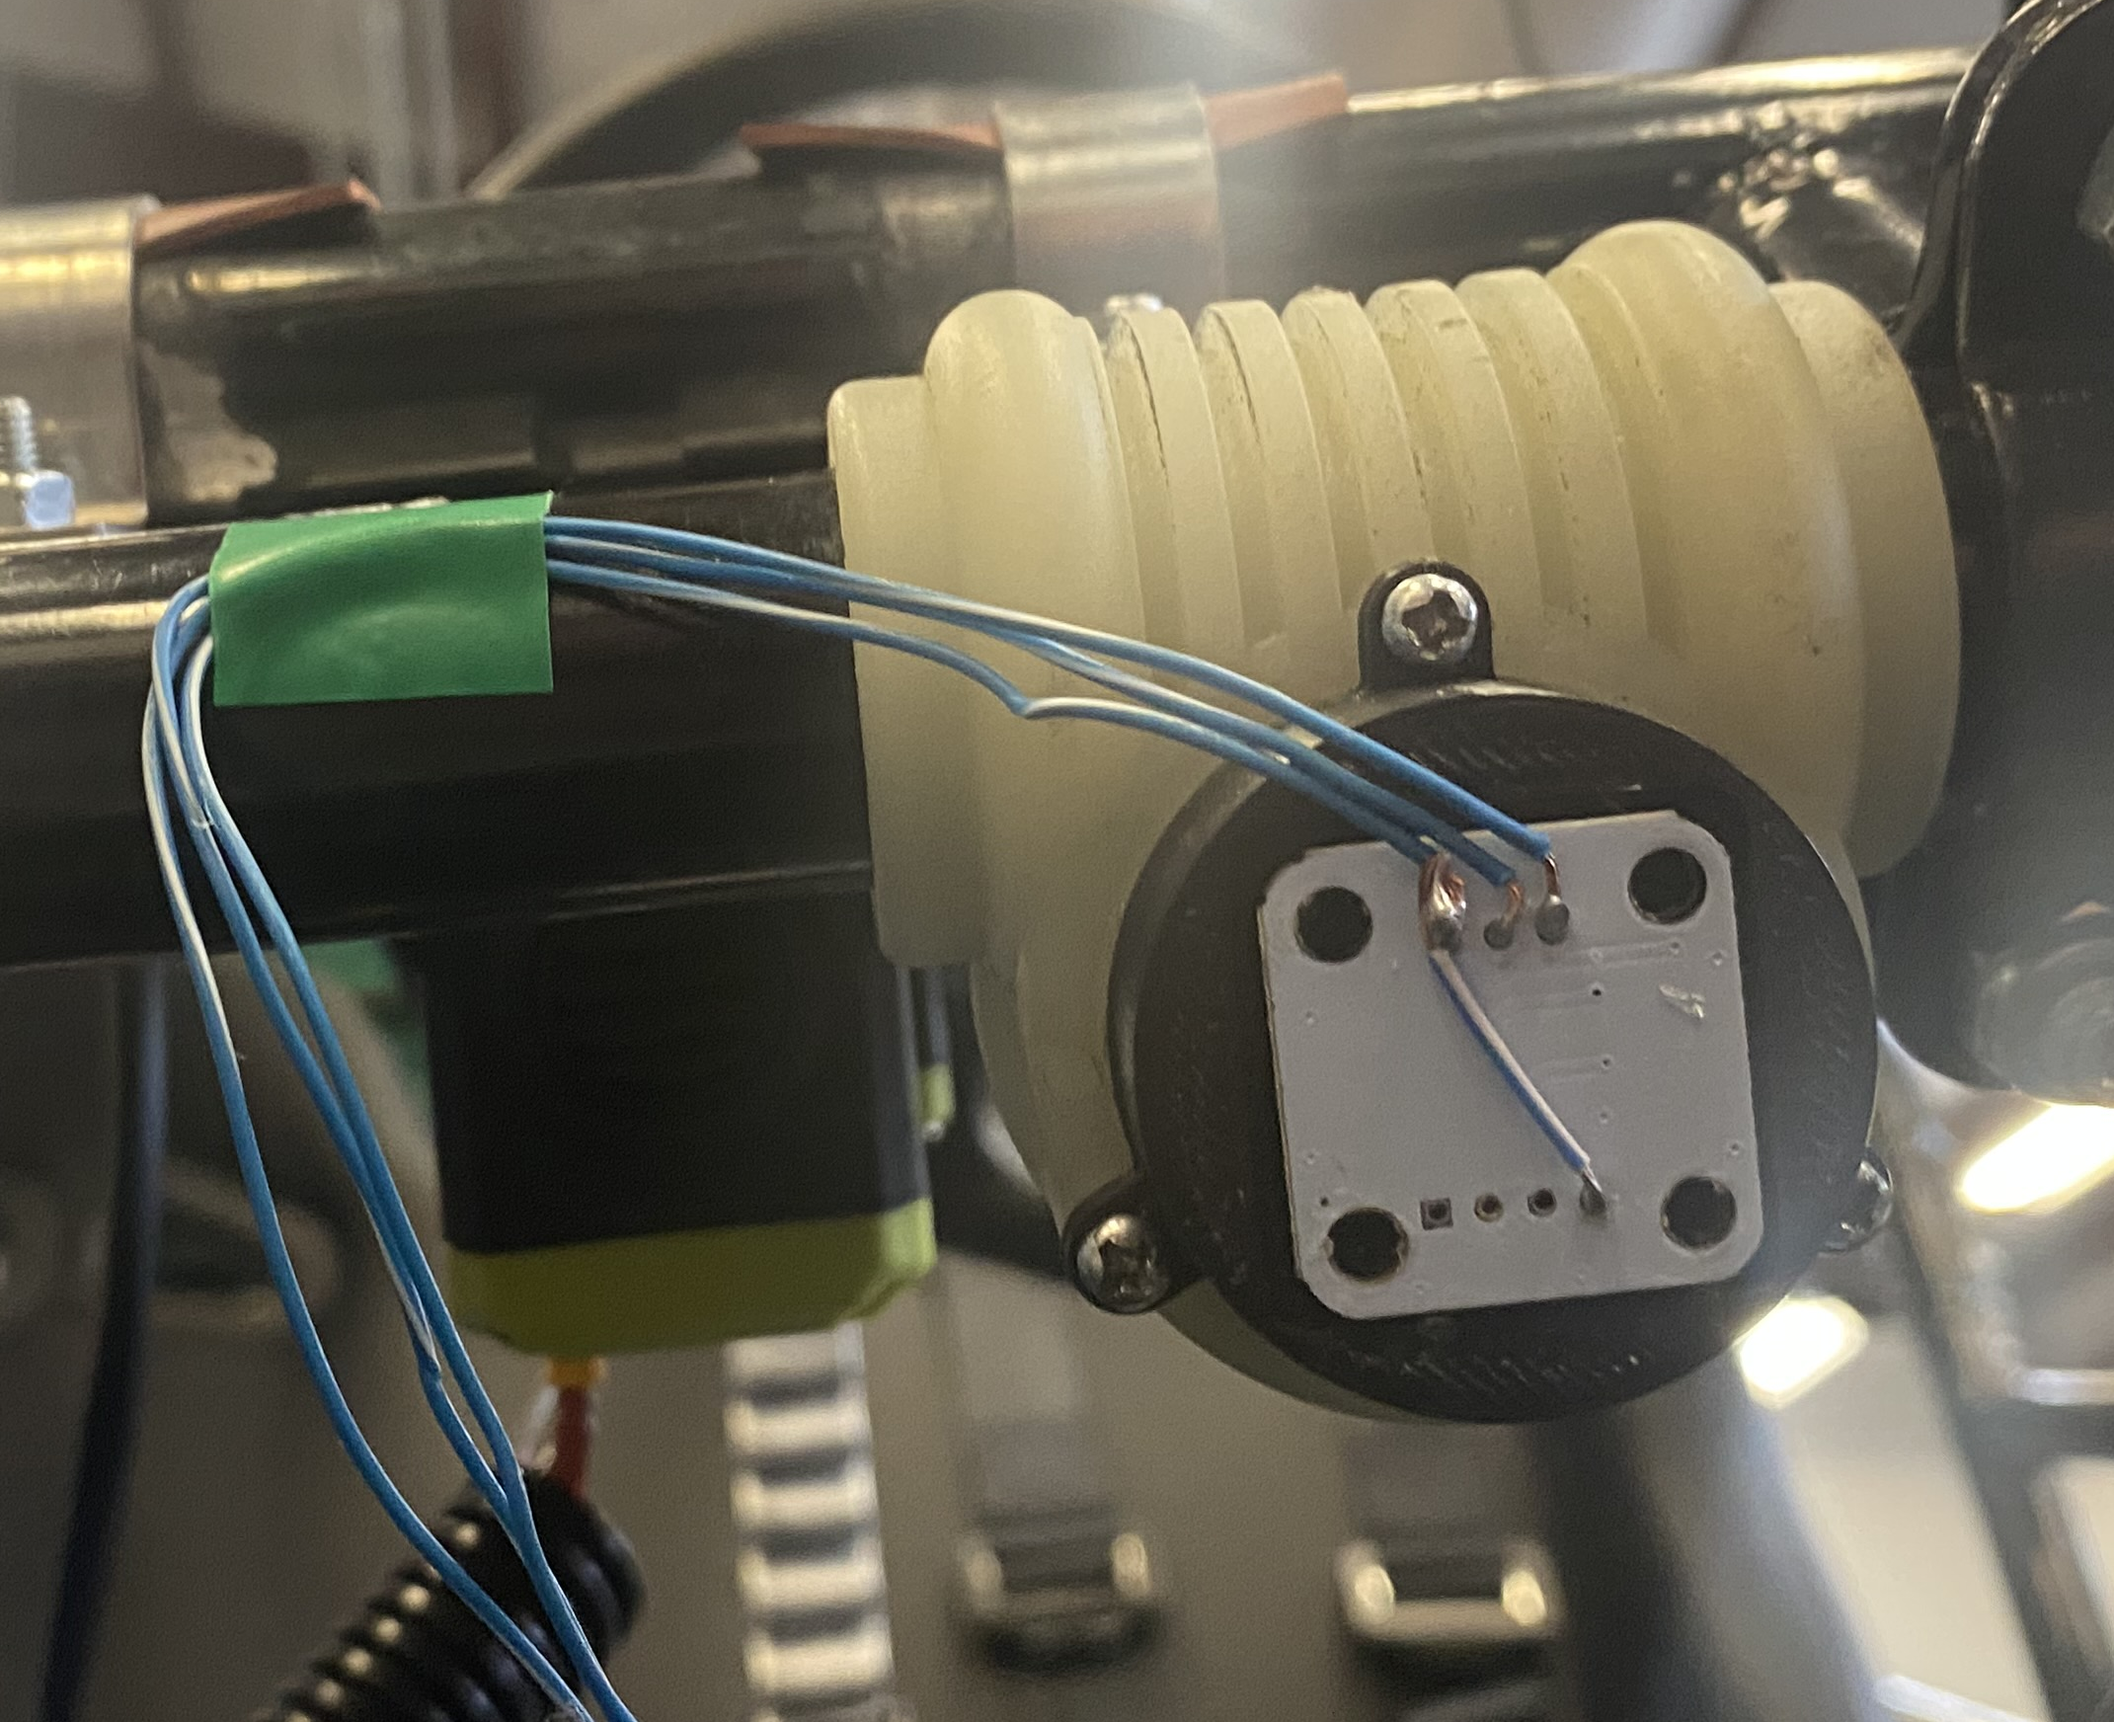
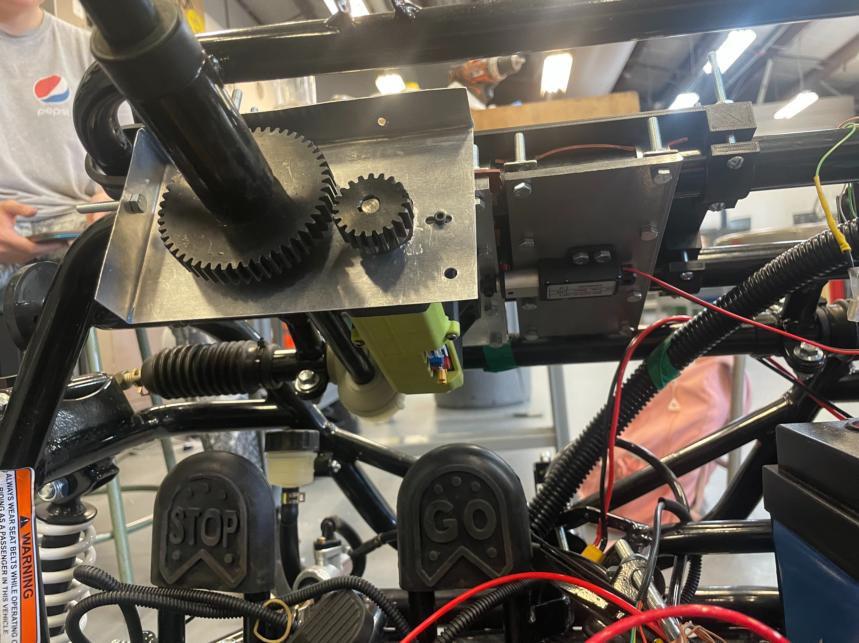
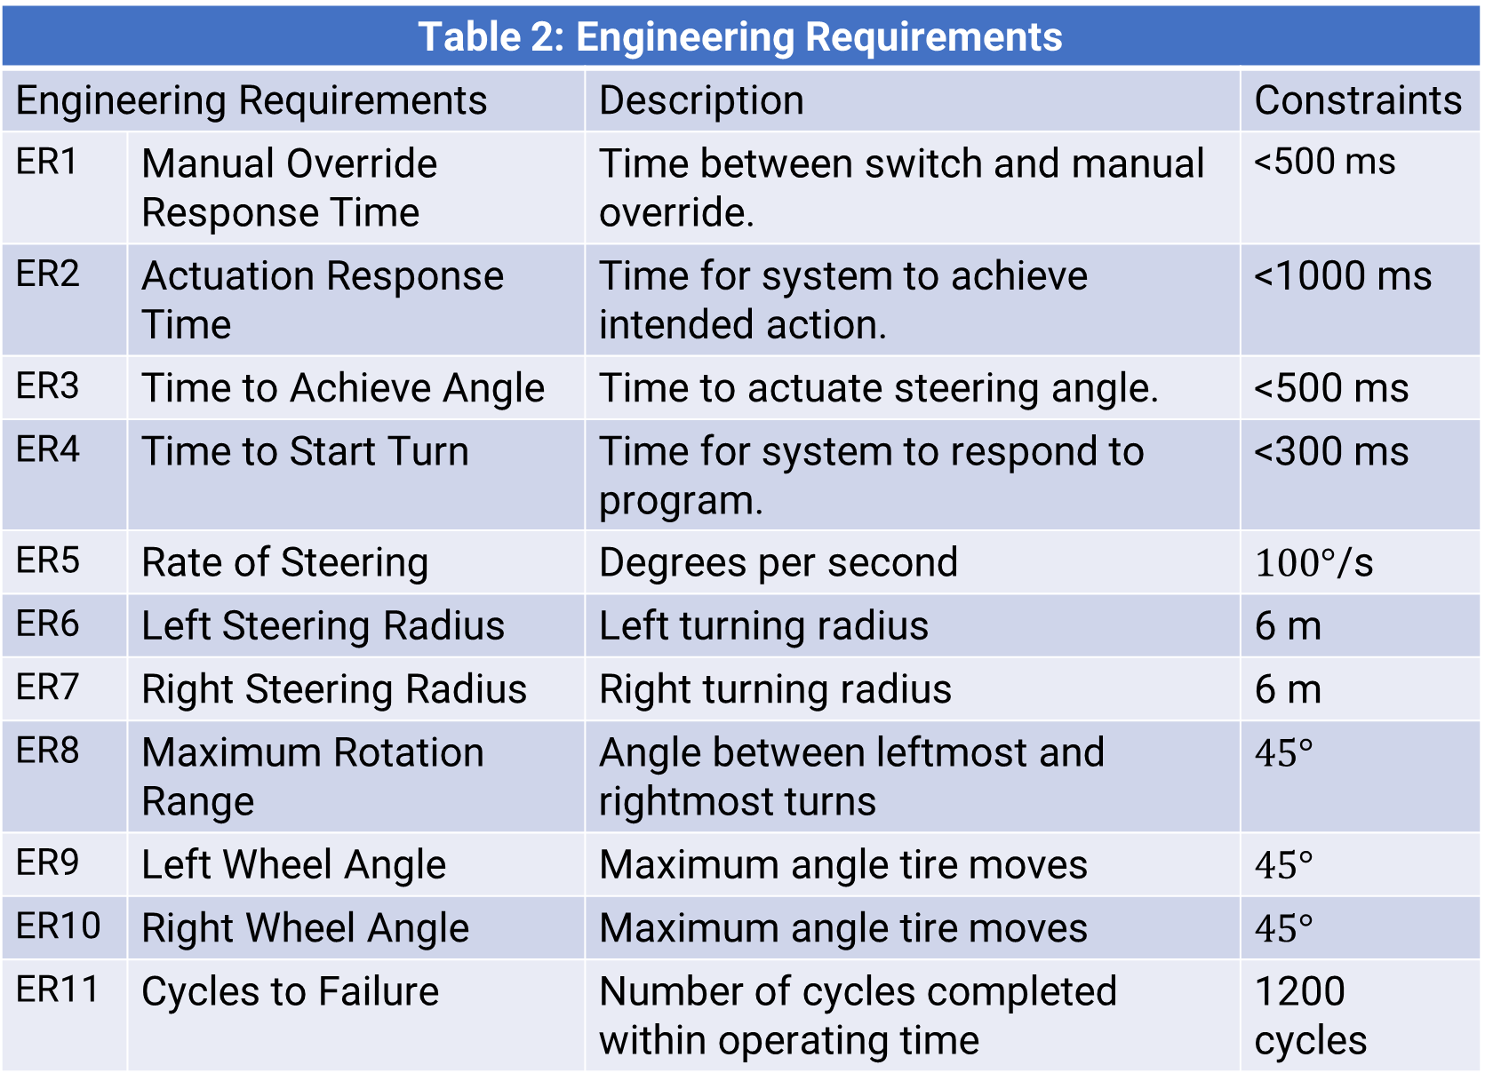
Boeing Sponsored Retrofitted Go-Kart for Autonomous Driving - Steering
Spring 2026
Desirae Mangum Selina Cozens Lily Quintanar
Steve Sanghi College of Engineering Northern Arizona University, Flagstaff, AZ 86011
Abstract
Methods
Conclusion
The steering subsystem is responsible for executing navigation of the autonomous go kart. The goal of the steering sub-team was to design and manufacture a mechanical subsystem that can safely and effectively navigate the vehicle while avoiding obstacles. The system required an emergency stop with a response time or 500 ms and an ability to operate for 20 hours. Ultimately, the team chose to design an electric power steering system utilizing a servo motor and gear system to move the steering wheel. Through prototyping motor mounts, different gear options, and mechanical fail safes, the team has successfully created a system that actuates navigation from autonomous programming. On top of this, the system complies with requirements set by the project’s sponsor as well as the team, which emphasize safety and, of course, autonomous navigation. Overall, the work that the steering sub-team has done gives insight into how retrofitting a vehicle’s steering system can be possible.
Researched steering subsystem standards and regulations before design
Created prototypes in SolidWorks using a 3D scan for accurate sizing
3D printed initial designs in PLA, then transitioned to stronger materials
Performed calculations to verify material selection, dimensions, and structural integrity
Used aluminum, steel, and PLA in final designs
Testing requires one ME and one EE
Testing equipment includes a camera, measuring tape, timer, and clean dry road
Data will be analyzed to improve the steering subsystem
The steering mechanism of the autonomous go-kart uses modern engineering methods to seamlessly control the go-kart’s direction. Through a powered steering mechanism, the steering design employs the use of a servo motor, gears system and encoders to control the pre-existing steering body. For an autonomous adventure, the servo motor and gear system work together to turn the steering column based on programmed commands and navigation. To have a passenger manually drive the vehicle, the top encoder tracks the wheel rotation and communicates with the motor to effectively turn the tires. Through, this system the passenger can control the go-kart's direction in a safe and reliable manner.
This design demonstrates a unique approach to redefining the way existing vehicles control direction beyond lane assist. Through effective calculations and analyses, the subsystem aims to fulfill the future of autonomous driving, allowing passengers the option of a hands-free ride or a manual driving method.
Table 3: Testing Summary
Experiment/Test | Relevant DRs | Testing Equipment Needed | Other Resources
EXP1 - Motor Controlled Steering Test | ER6- Left Turn Radius, ER7- Right Turn Radius | Means to make a video, & Measuring Tape | A good weather day, Empty parking lot, Driver
EXP2- Time Test 1 (Steering Dynamics) | ER3- Time to Achieve Angle, ER4- Time to Start Turn, ER5- Rate of Steering | Means to make a video, Measuring Tape, & Phone Timer | A good weather day, Empty parking lot
EXP3- Time Test 2 (Override and Safety Response) | ER1- Manual Override Response, ER2- Actuation Response Time | Means to make a video, & Phone Timer | A good weather day, Empty parking lot
EXP4- Steering Rotation Range, and Stress Test | ER8- Max Rotation Range, ER11- Cycles to failure | Means to make a video, track cycles, & mark rotation | A good weather day, Empty parking lot, 3 hours
References
Results
[1] N. H. T. S. A. part of the U.S. Department of Transportation, “Automated vehicles for safety,” NHTSA, https://www.nhtsa.gov/vehicle-safety/automated-vehicles-safety (accessed Sep. 17, 2025).
[2] Y. W. Jeong, C. C. Chung and W. Kim, "Nonlinear Hybrid Impedance Control for Steering Control of Rack-Mounted Electric Power Steering in Autonomous Vehicles," in IEEE Transactions on Intelligent Transportation Systems, vol. 21, no. 7, pp. 2956-2965, July 2020, doi: 10.1109/TITS.2019.2921893
[3] A. Pushpakanth and M. N. Dhavalikar, Development of Steering Control System for Autonomous Vehicle,https://www.ijrte.org/wp-content/uploads/papers/v11i2/B71050711222.pdf (accessed Sep. 15, 2025). Development of Steering Control System for Autonomous Vehicle
[4] J. Vogel, “Tech Explained: Ackermann Steering Geometry,” Racecar Engineering, Apr. 06, 2021. https://www.racecar-engineering.com/articles/tech-explained-ackermann-steering-geometry/[41] R. Budynas, Shigley’s Mechanical Engineering Design ISE. McGraw Hill, 2024.
[5] E. Oberg and C. J. Mccauley, Machinery’s handbook : a reference book for the mechanical engineer, designer, manufacturing engineer, draftsman, toolmaker, and machinist. New York: Industrial Press, 2012.
Requirements
Table 1: Customer Requirements
Customer Requirement |  | Description
CR1 | Autonomous Steering | Vehicle steers without human intervention.
CR2 | Obstacle Detection/Avoidance | Vehicle navigates around obstacles.
CR3 | User Control | Vehicle can be steered manually.
CR4 | Safety | System has an emergency stop.
CR5 | Usability | Ease of use; easily switched between manual and autonomous modes.
Table 2: Engineering Requirements
Engineering Requirements |  | Description | Constraints
ER1 | Manual Override Response Time | Time between switch and manual override. | <500 ms
ER2 | Actuation Response Time | Time for system to achieve intended action. | <1000 ms
ER3 | Time to Achieve Angle | Time to actuate steering angle. | <500 ms
ER4 | Time to Start Turn | Time for system to respond to program. | <300 ms
ER5 | Rate of Steering | Degrees per second | $100°$/s
ER6 | Left Steering Radius | Left turning radius | 6 m
ER7 | Right Steering Radius | Right turning radius | 6 m
ER8 | Maximum Rotation Range | Angle between leftmost and rightmost turns | $45°$
ER9 | Left Wheel Angle | Maximum angle tire moves | $45°$
ER10 | Right Wheel Angle | Maximum angle tire moves | $45°$
ER11 | Cycles to Failure | Number of cycles completed within operating time | 1200 cycles
Top-level CAD of Steering Assembly
Protective Cover for Steering Assembly
Acknowledgements
We would like to thank our:
Clients at Boeing: Conner Nolan and Donald Guzman for providing funding and resources
Advisors: Professor David Willy and Teresa McLaurin for their guidance and feedback during this project
Supporters: RedRock Manufacturing, Canes, Chipotle, our friends and family who donated funding or resources
Top Encoder Mount
Bottom Encoder Mount
Interior of Gearbox

Slide 3

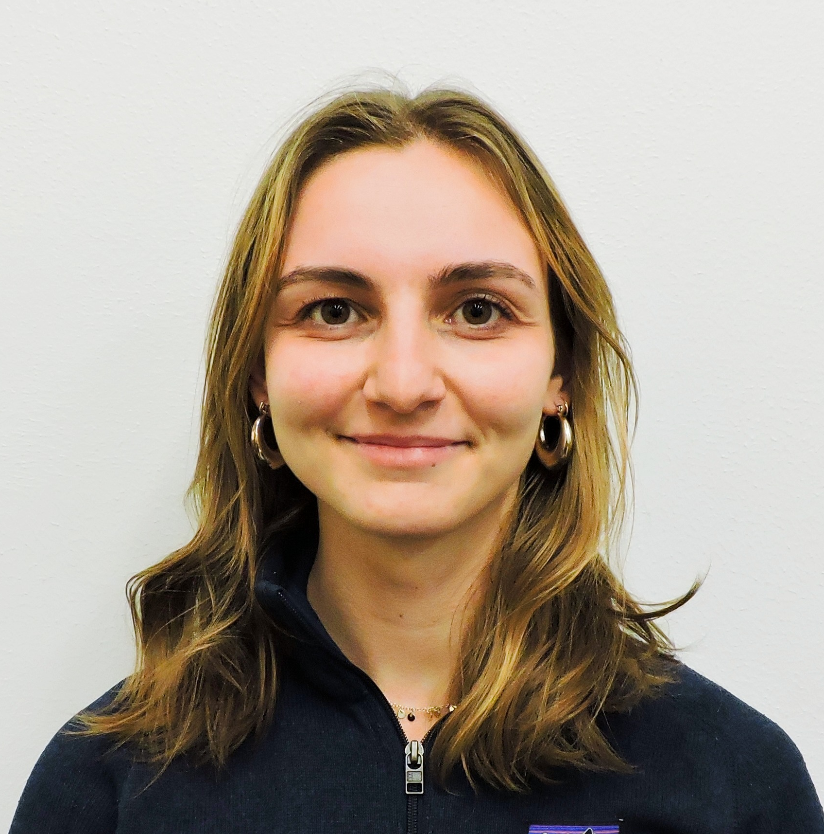
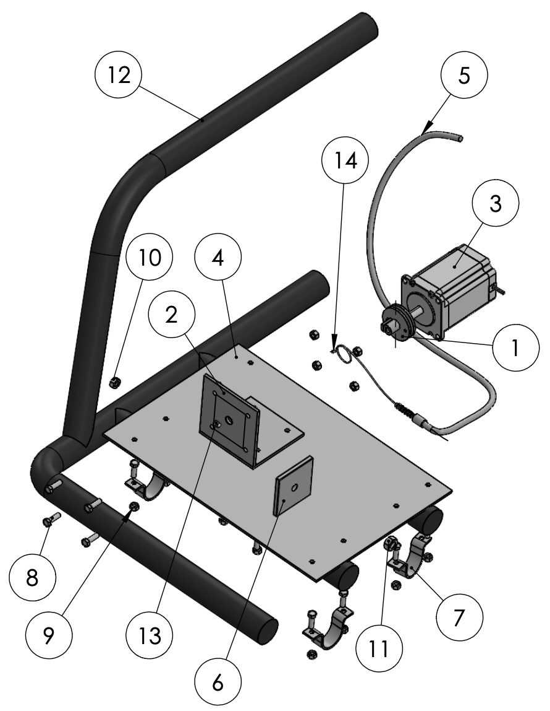
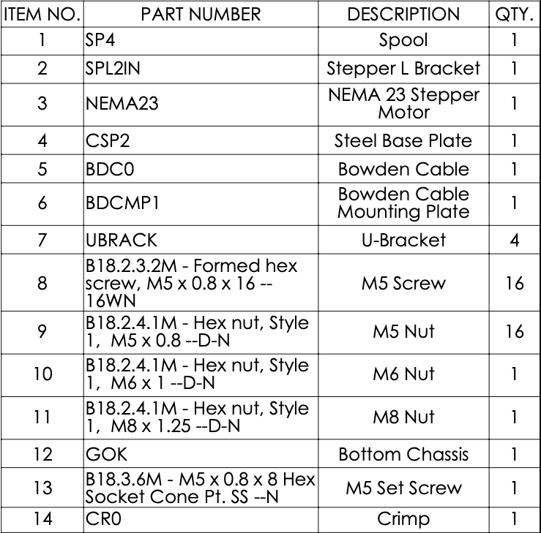
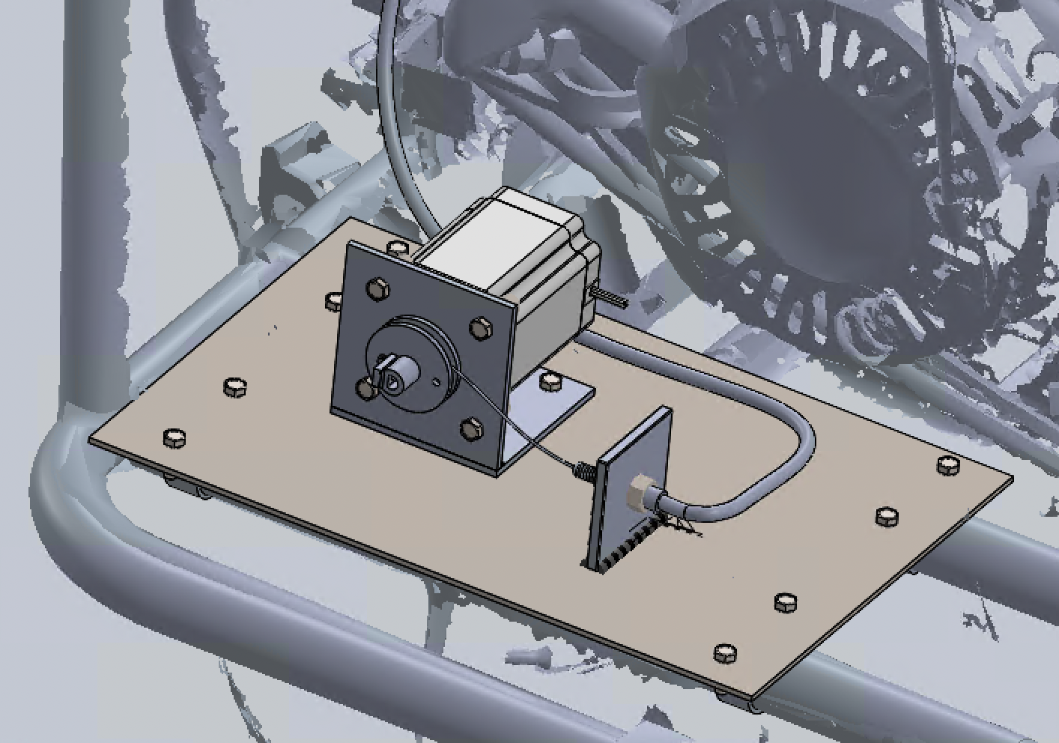
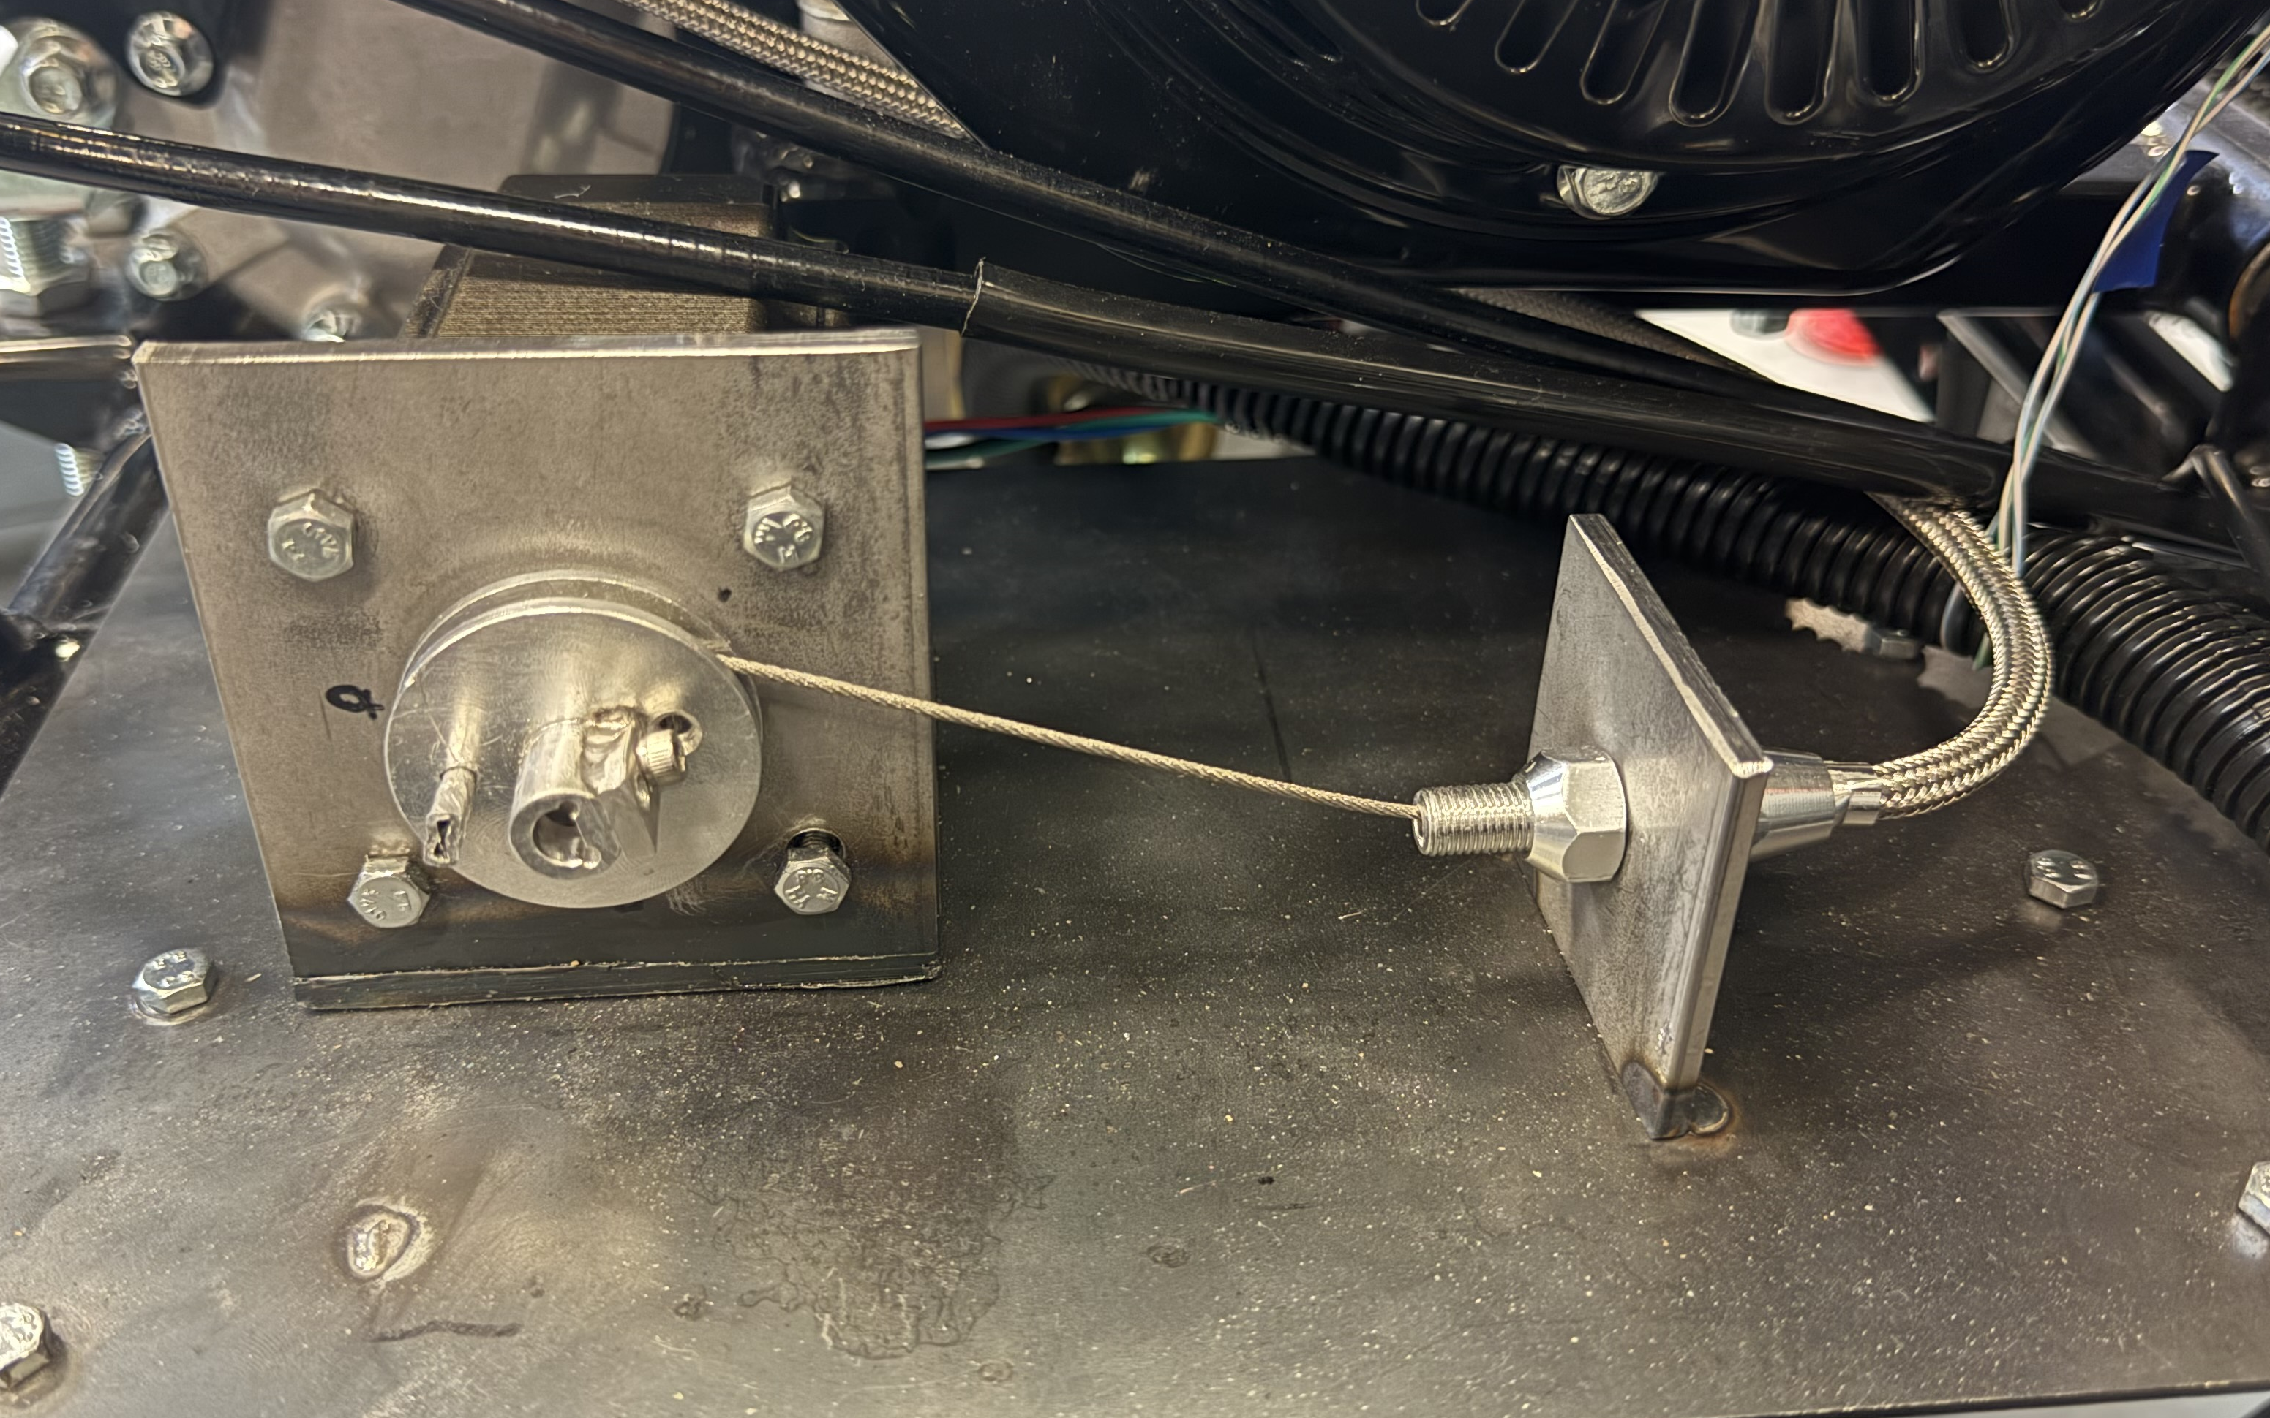
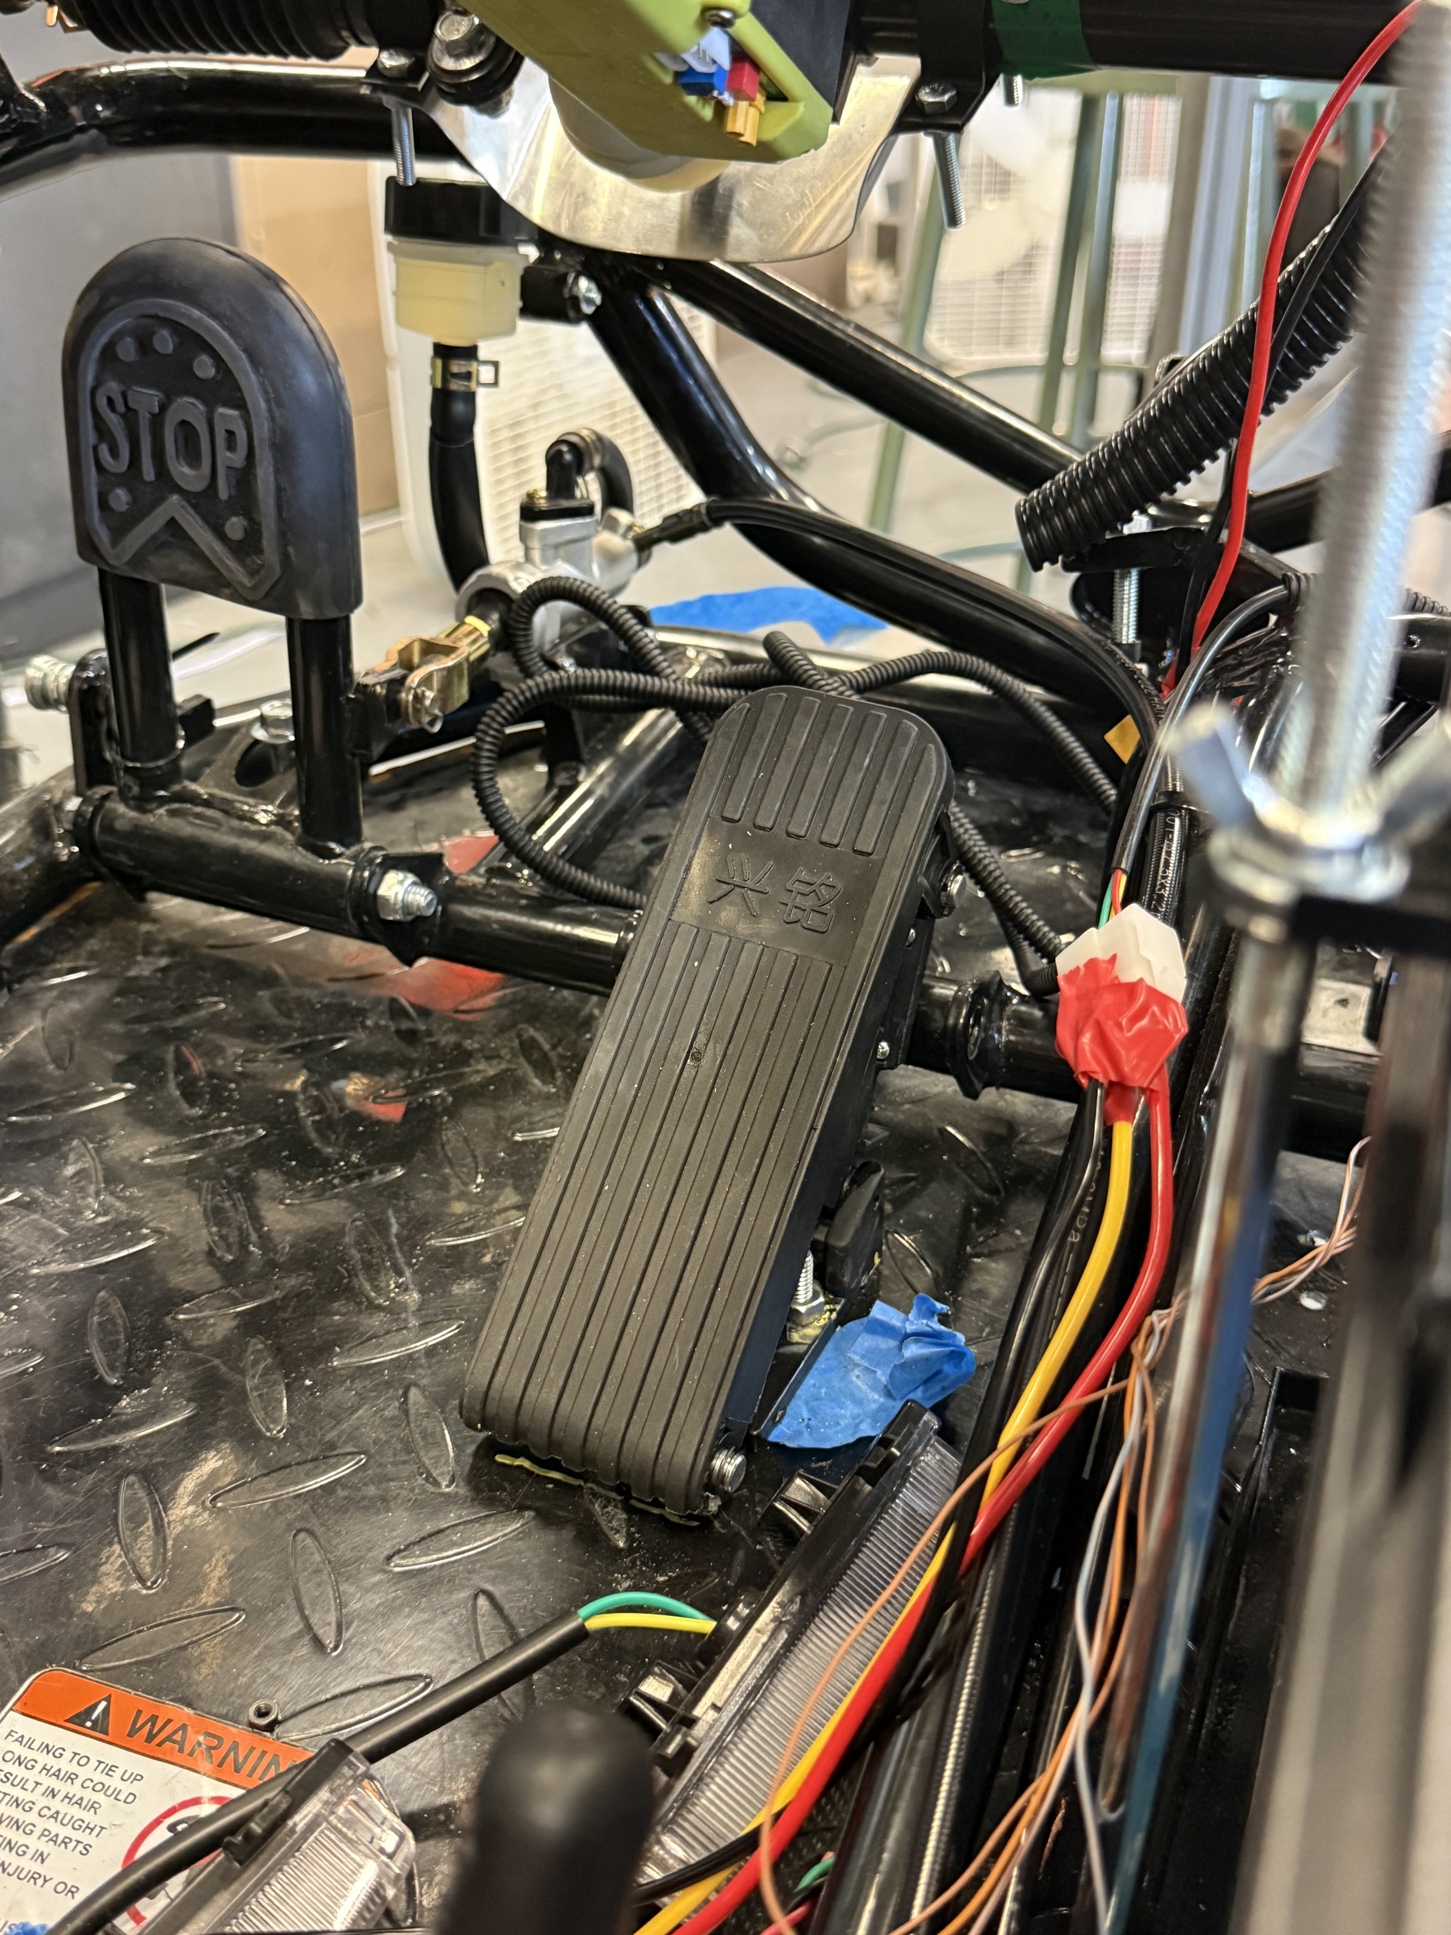
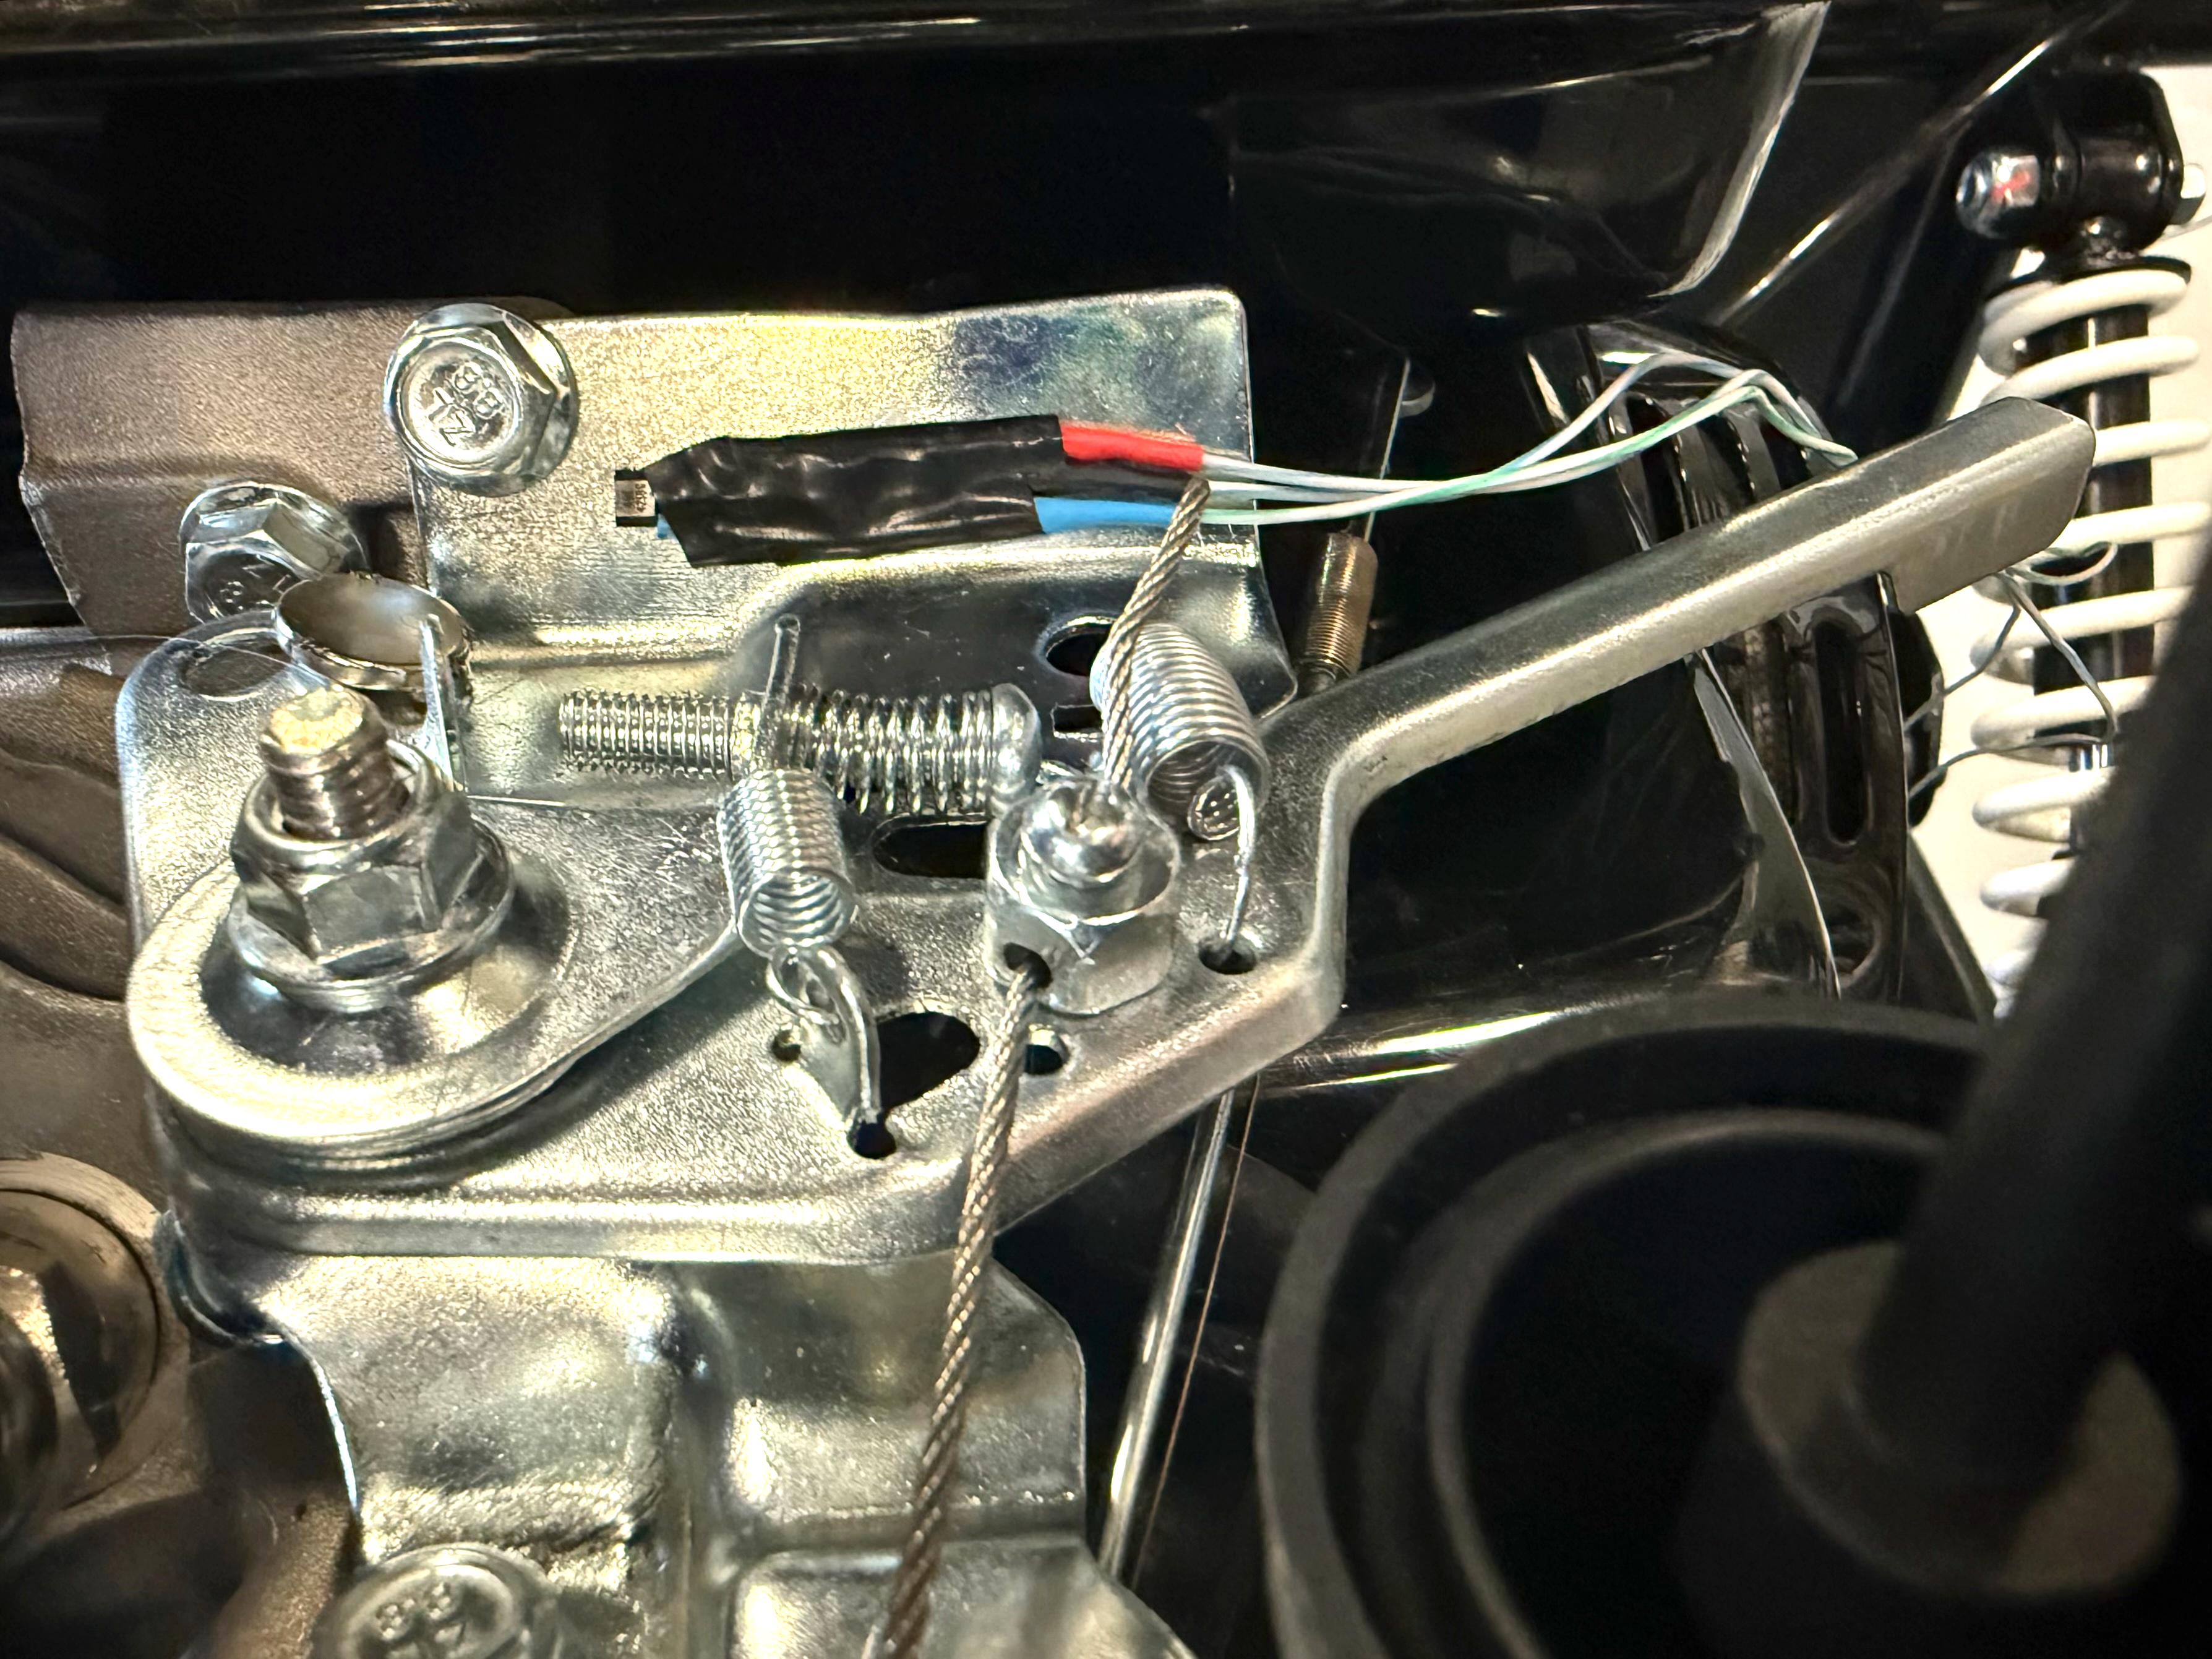
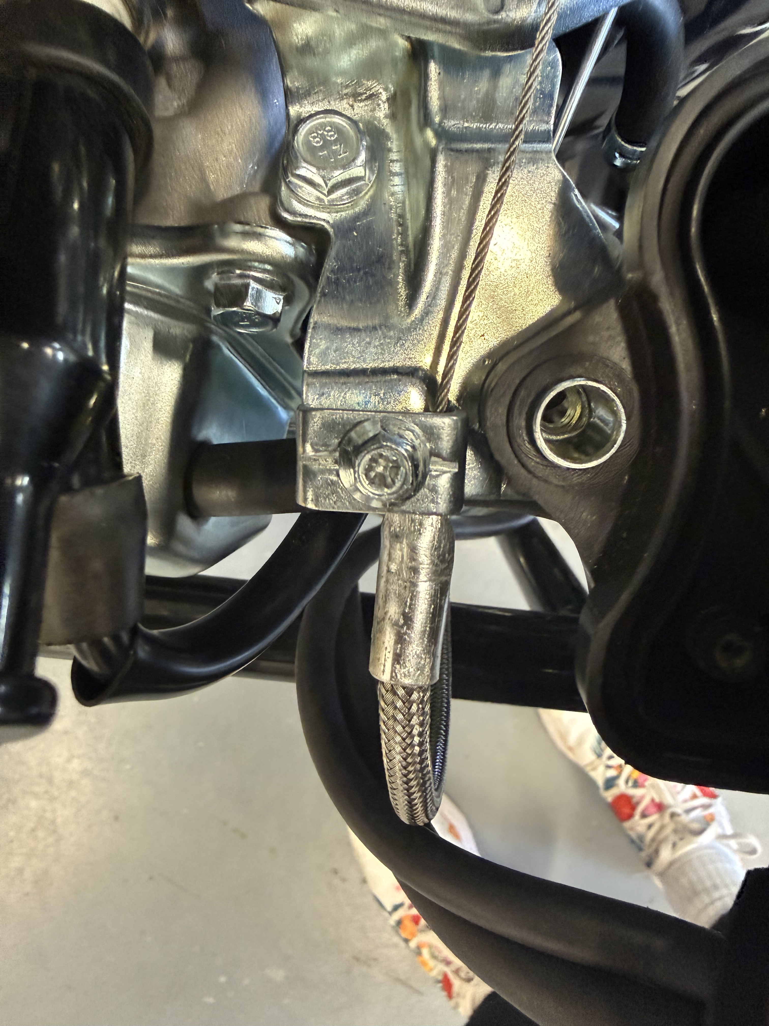
Boeing Sponsored Retrofitted Go-Kart for Autonomous Driving - Throttle
Spring 2026
Natasa Peric Elise Chantegros
Steve Sanghi College of Engineering, Northern Arizona University, Flagstaff, AZ 86011
Abstract
Methods
Conclusion
To control the acceleration of the autonomous go-kart, the throttle sub-system retrofitted a fly-by-wire design to regulate the go-kart’s speed. This design enables a driver to ride in either autonomous or manual mode.
For the throttle sub-system, the team analyzed the original mechanism to determine which values were most trivial to the go-kart’s speed. Using this information, the team chose a stepper motor and a Bowden cable to control the throttle lever within 50ms. The motor was mounted to a steel platform perpendicular to the Bowden cable, providing a direct line of tension. The other end of the cable was fastened to the throttle body so that the Bowden cable body would remain static while the wire cable pulls the throttle lever with at least at least 60N of force. The spool was secured to the motor shaft using set screws, and the cable was secured onto it with a crimp. To manually drive the go-kart, an electric pedal was installed to work within 500ms in tandem with the motor.
After testing and optimization, the design achieved a top speed of 13.14kph. Mirroring a fly-by-wire mechanism, the throttle design provides autonomous acceleration to ensure safe and reliable ride.
Main Components
Electric Pedal, Bowden cable, Return Spring, Stepper Motor, and Spool
Testing
Measure applied forces to the pedal, throttle lever, and Bowden cable using a fish scale
Measuring spring force as a function of displacement
System Response
Measure the time required for the throttle lever to move after a command was sent to the stepper motor
Force-displacement analysis to determine the throttle lever spring constant (k).
Multiple trials were conducted, and results were averaged to analyze trends and results.
The throttle mechanism of the autonomous go-kart uses modern engineering methods to seamlessly control the go-kart’s speed. Through a drive-by-wire mechanism, the throttle design employs the use of a stepper motor, Bowden cable, and electric pedal to control the pre-existing throttle body. For an autonomous journey, the stepper motor and Bowden cable work together to pull the throttle lever based on programmed commands. To have a passenger manually drive the vehicle, the electric pedal works directly with the stepper motor to effectively pull and release the throttle lever. Through this system, the passenger can control the go-kart’s speed in a safe and reliable manner.
This design demonstrates a unique approach to redefining the way existing vehicles control speed beyond cruise control. Through effective calculations and analyses, the subsystem aims to fulfill the future of autonomous driving, allowing passengers the option of a hands-free ride or a manual driving method.
Requirements
Throttle Customer Requirement Summary Table
Customer Requirement | Description
CR1 – Autonomous Navigation | Go-Kart speed is regulated using autonomous inputs.
CR2 – User Control/Manual Override | Mechanical pedal controls the speed without delay or failure.
CR3 – State Monitoring/Diagnostics | The computer system can consistently monitor the go-kart’s speed.
CR4 – Performance | Throttle is regulated using electrical inputs.
CR5 – Safety | Autonomous throttle can be disengaged at any time.
CR6 – Usability | The throttle can be easily switched between autonomous and manual mode.
References
[1] E. Oberg and C. J. Mccauley, Machinery’s handbook : a reference book for the mechanical engineer, designer, manufacturing engineer, draftsman, toolmaker, and machinist. New York: Industrial Press, 2012.
[2] J. L. Meriam and L. G. Kraige, Engineering mechanics. Vol. 2, Dynamics. Hoboken, N.J.: Wiley ; Chichester, 2012.
[3] J. E. Shigley, C. R. Mischke, and T. H. Brown, Shigley’s mechanical engineering design, 11th ed. New York, NY, USA: McGraw-Hill Education, 2020.
[4] W. F. Milliken and D. L. Milliken, Race car vehicle dynamics. Warrendale, PA, USA: SAE International, 1995.
[5] H. Olsson, K. J. Åström, C. Canudas de Wit, M. Gäfvert, and P. Lischinsky, “Friction Models and Friction Compensation,” European Journal of Control, vol. 4, no. 3, pp. 176–195, Jan. 1998, doi: https://doi.org/10.1016/s0947-3580(98)70113-x.
Results
Throttle Engineering Requirements Summary Table
Engineering Requirement | Description | Units
ER1 – Maximum Speed | Up to 14 kph ~ 3.889 m/s | m/s
ER2 – Throttle Lever Force | Force range required to push the throttle from 0 to full acceleration | N
ER3 – Manual Override Response Time | Minimum 500 ms response time of the electric pedal | ms
ER4 – Actuation Response Time | 37 – 54 ms response time of the stepper motor | ms
ER5 – Failsafe Response Time | Minimum 500 ms response time to release throttle lever to 0 | ms
ER6 – Electrical Pedal Force Range | 35-55 N required to push the electric pedal to full throttle | N
ER7 – Throttle Cable Velocity | 0.46-0.66 m/s required to actuate the motor for full throttle control | m/s
ER8 – Spool RPM at Maximum Throttle | 450-650 rpm range to pull the cable based on commands | rpm
ER9 – Required Force to Pull Throttle Cable | 60-65 N required to pull the cable | N
Final CAD of Throttle Assembly
Stepper Mechanism
Acknowledgements
We would like to thank our:
Clients at Boeing: Conner Nolan, Donald Guzman for providing funding and resources
Advisors: Professor David Willy and Teresa McLaurin for their guidance and feedback during this project
Supporters: RedRock Manufacturing, Canes, Chipotle, our friends and family who donated funding or resources
Electric Pedal
Spring System and Hall Effect Sensor
Throttle Cable Mount

